Slide 1

Programming from zero to hero
With python programming language
By Mehran Tarif

Slide 2
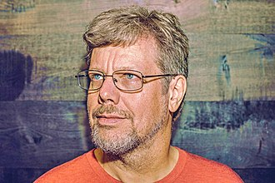
What is Python?
Python is a high-level, interpreted, general-purpose programming language. Its design philosophy emphasizes code readability with the use of significant indentation.
Python is a versatile programming language with many use cases in a variety of different fields.
Guido van Rossum began working on Python in the late 1980s.

Slide 3
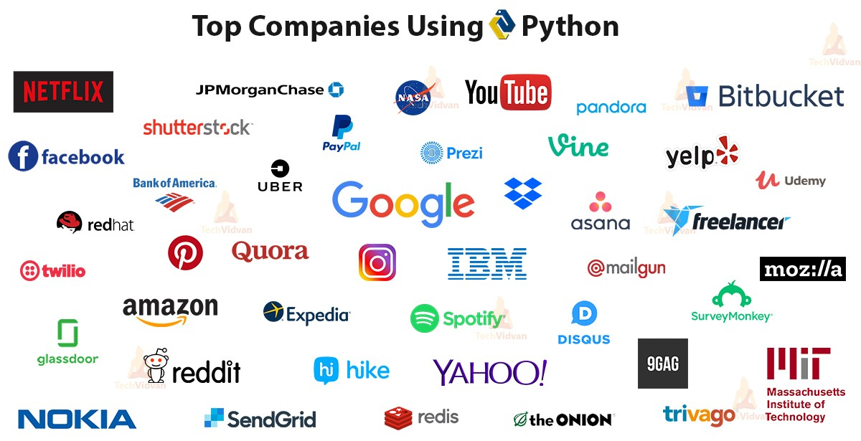

Slide 4
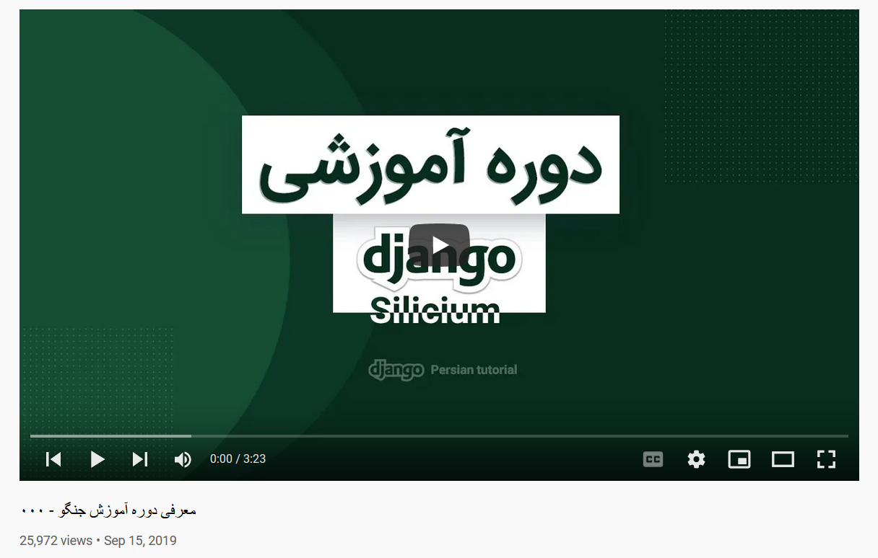
Web Development
Django
FastAPI
Flask
Tornado

Slide 5




GUI Development
Kivy
PyQt
PySimpleGUI
tkinter
wxPython

Slide 6
Game Development
Arcade
PyGame
pyglet

Slide 7
Machine Learning
Keras
NLTK
PyTorch
scikit-learn
TensorFlow

Slide 8
Scientific Computing
NumPy
SciPy
SimPy

Slide 9
Data Analysis and Visualization
Bokeh
Dash
Matplotlib
pandas
Seaborn
Folium

Slide 10
Web Scraping
Beautiful Soup
requests
Scrapy
urllib.request

Slide 11
Others?
Browser Automation
GUI Automation
Other bots like Telegram ..
Artificial Intelligence
Big Data
Network programming

Slide 12
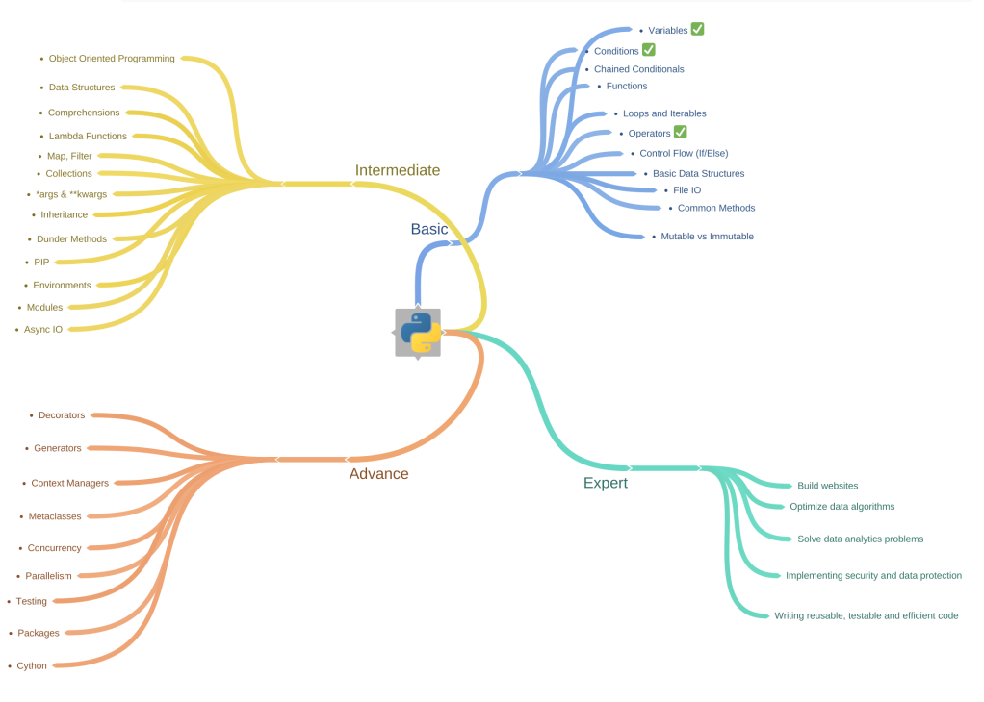

Slide 13
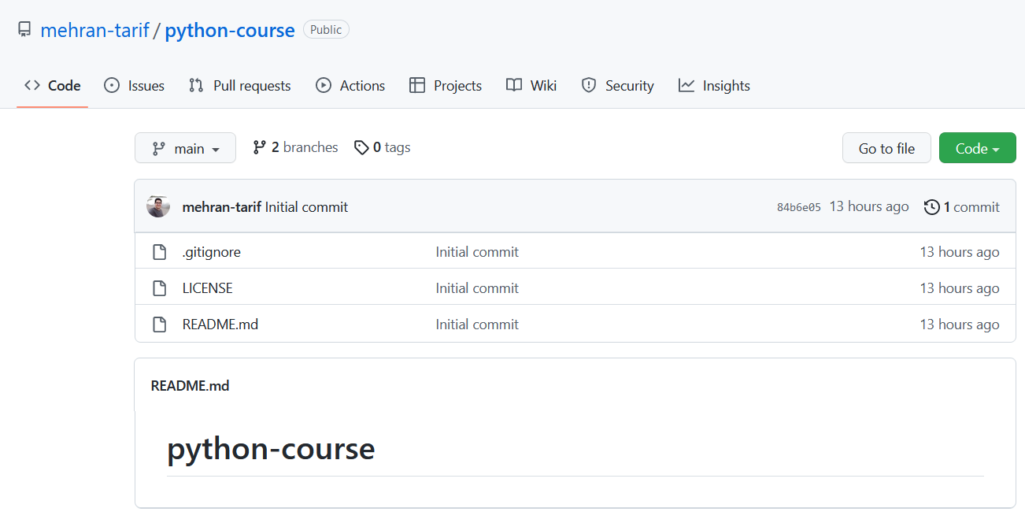
Project files

Slide 14
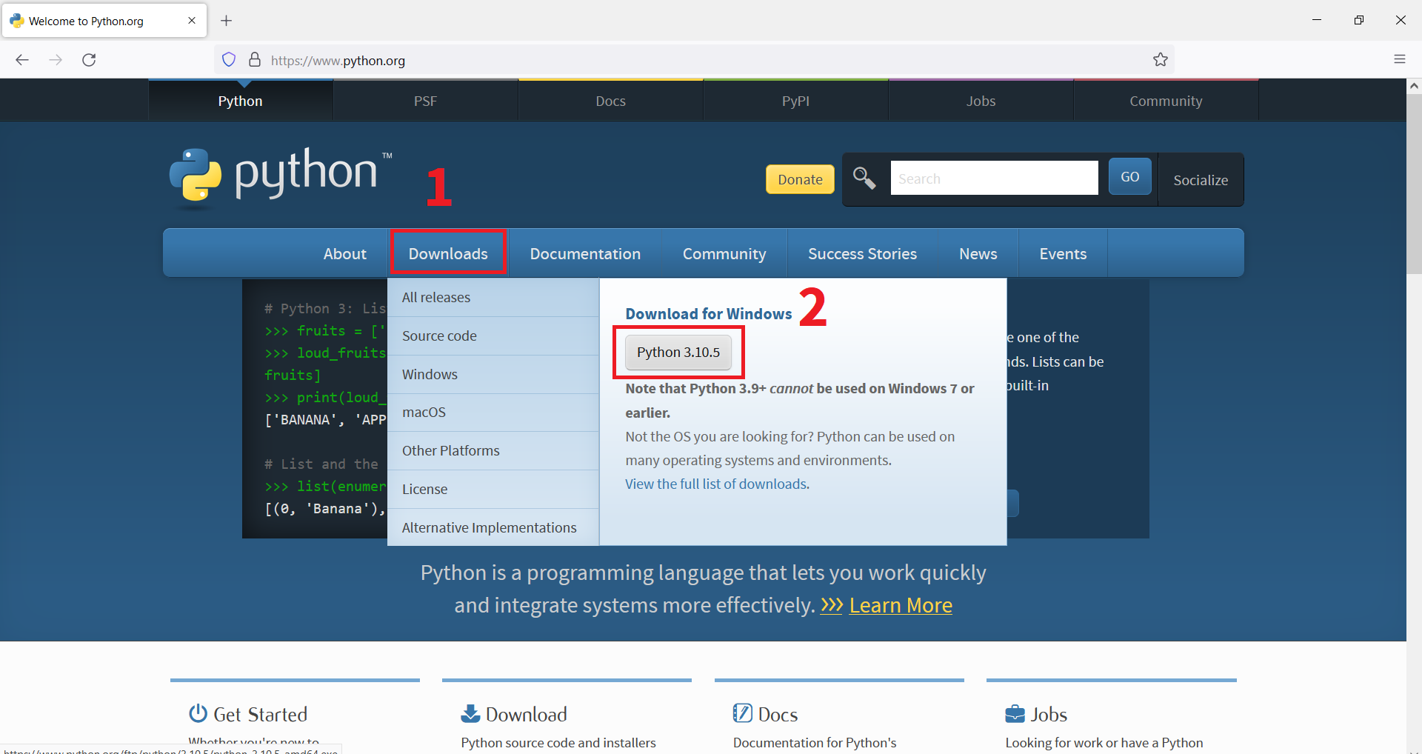
How to install python?

Slide 15
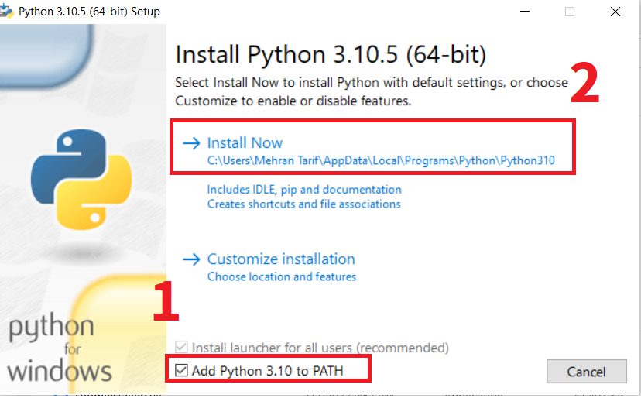
How to install python?

Slide 16
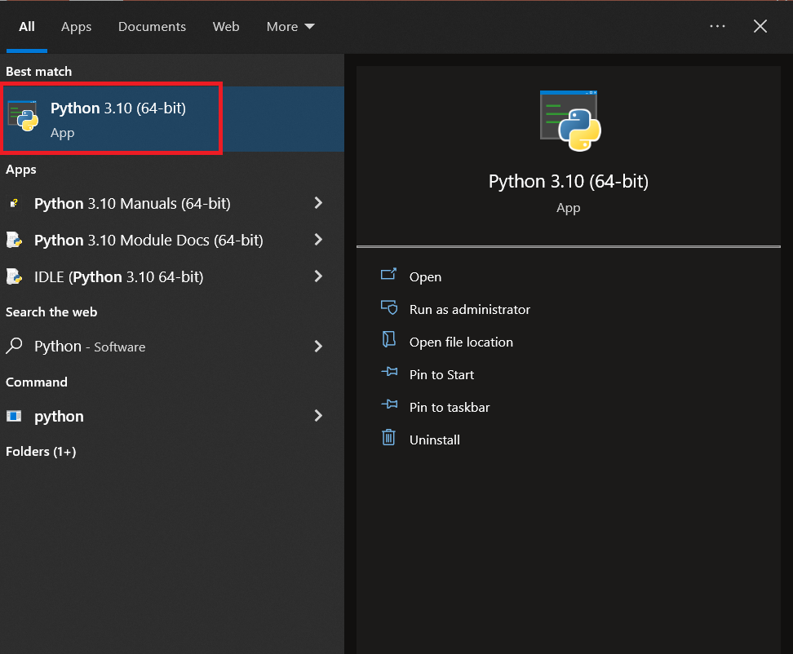
How to install python?

Slide 17
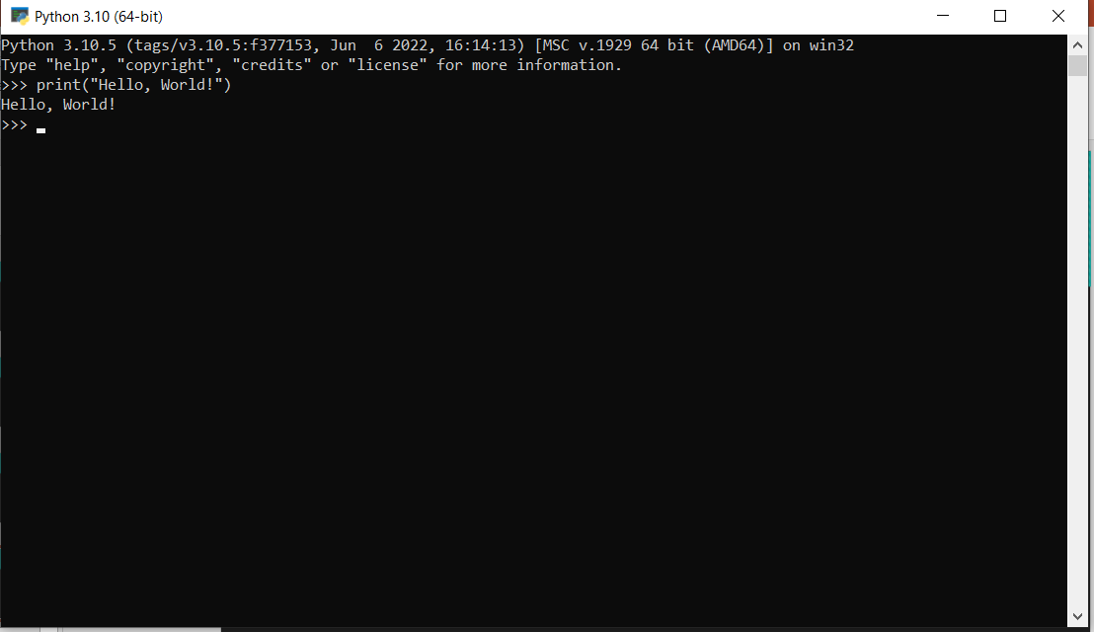
Python first program

Slide 18
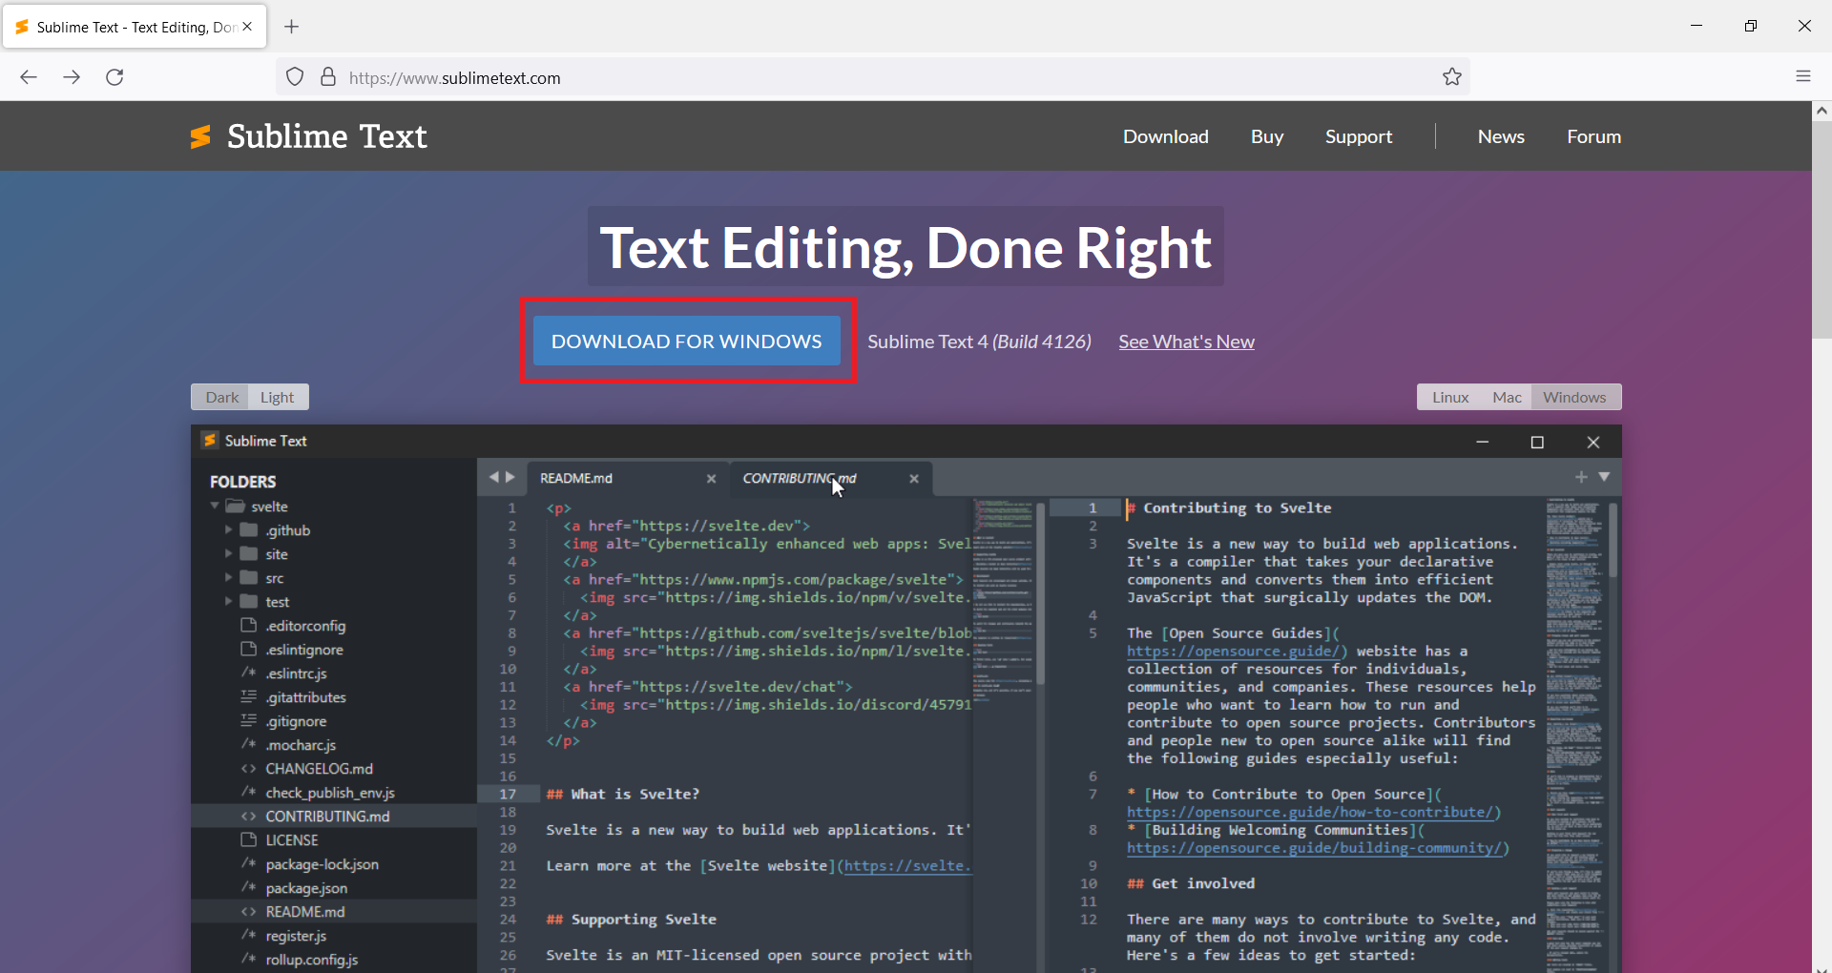
How to install sublime text

Slide 19
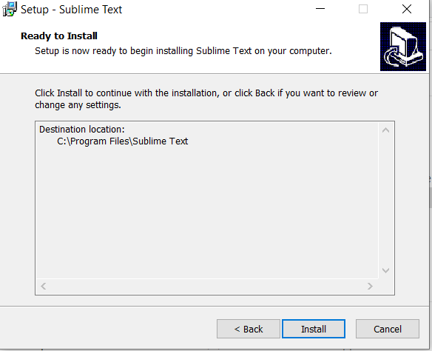
How to install sublime text

Slide 20
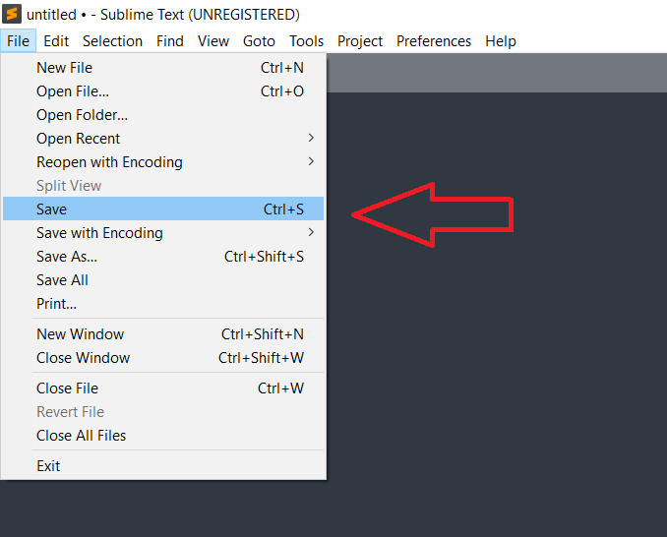
Create python file

Slide 21
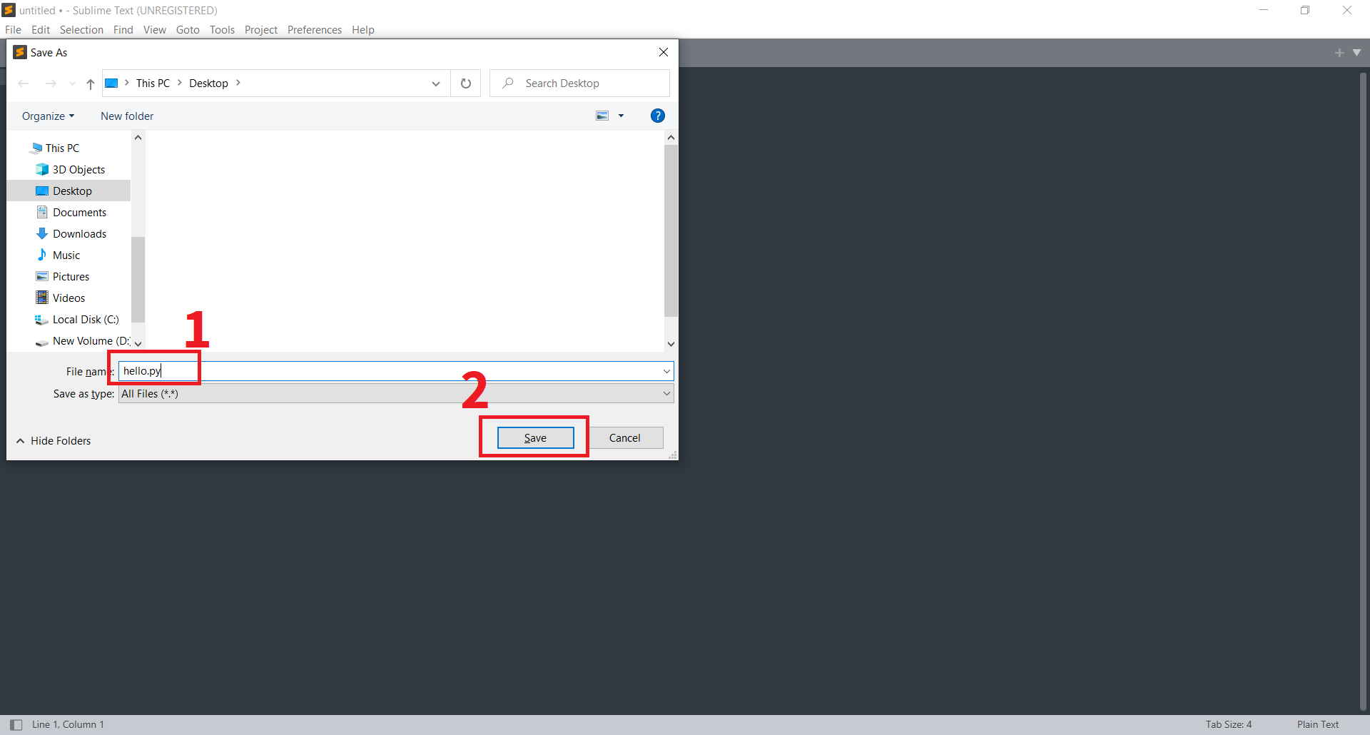
Create python file

Slide 22
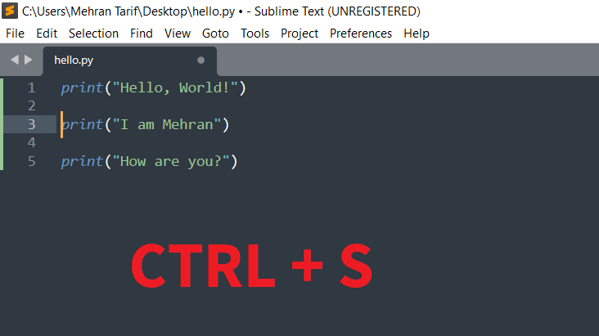
First app

Slide 23
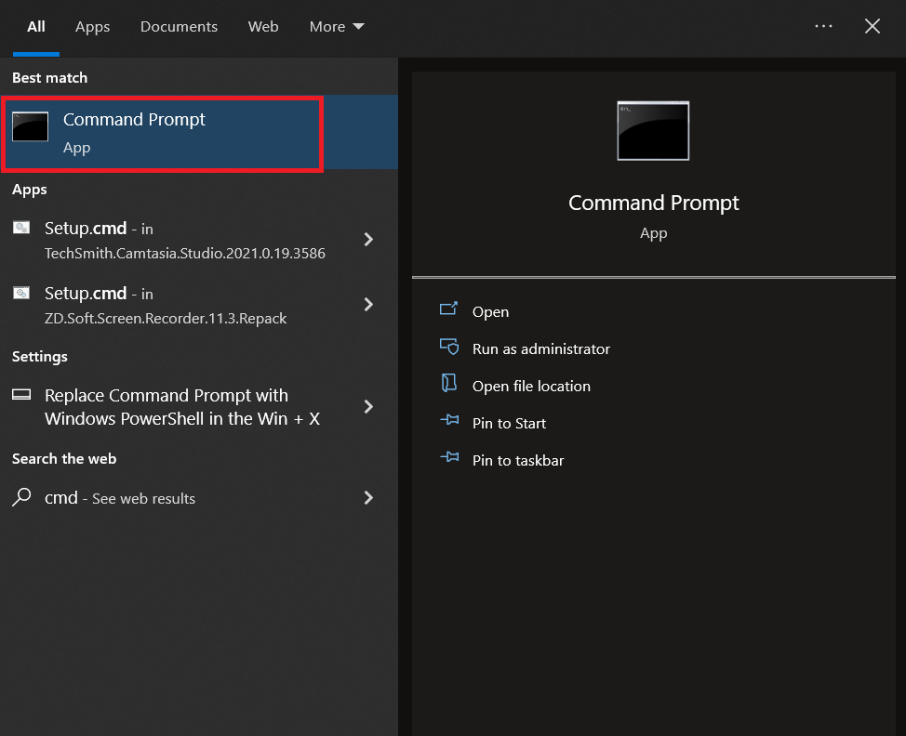
Run CMD

Slide 24
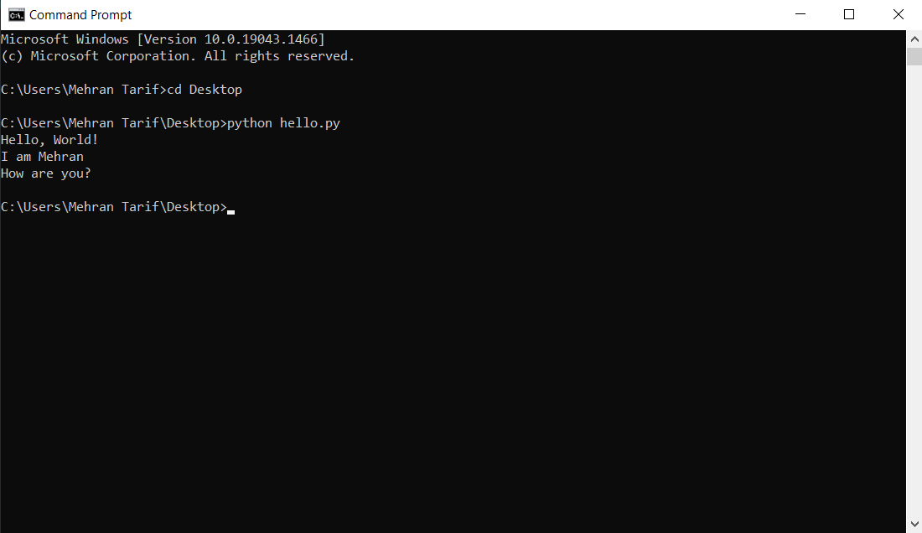
Run python codes

Slide 25
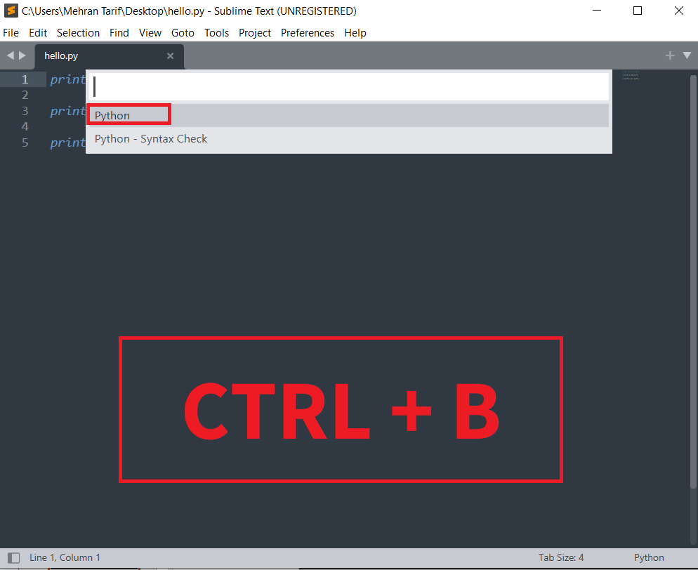
Better way to run python codes

Slide 26
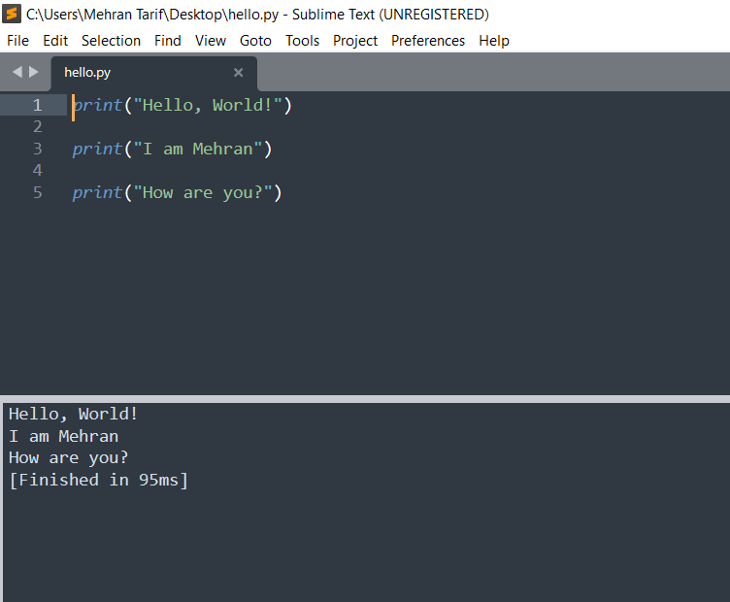
Better way to run python codes

Slide 27
READ OR WRITE?
Which one is harder?
Most Programmers Can't Read Code.
Reading code is much harder than writing it.

Slide 28
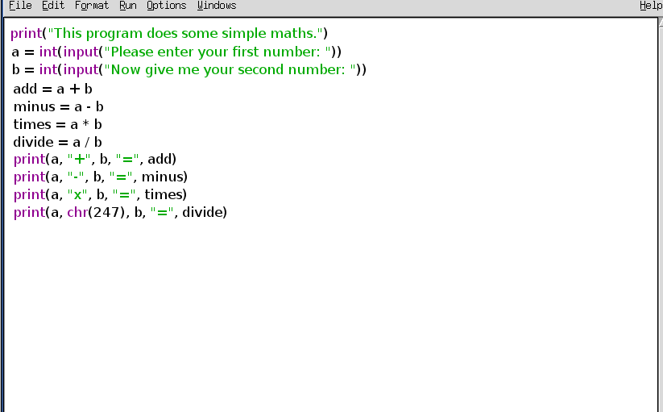
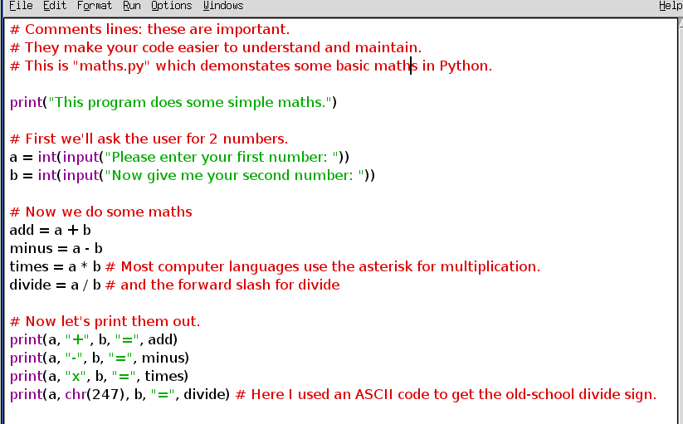
Comment importance

Slide 29
Comment importance
Reason #1
In an organization, we work in a team; there are many programmers who work on the same project. So, the well commented functions/logics are helpful to other programmers to understand the code better. They can easily understand the logic behind solving any problem.
Reason #2
If you see/edit code later, comments may help you to memorize your logic that you have written while writing that code.

Slide 30
Variables
Be of any length
Must not contain any spaces (‘my Name’ is incorrect Python variable name)
Contain digits and alphabets, but always start with an alphabet
Include uppercase alphabets. Python is case sensitive ( myname and myName are two different variables)
Can include underscore(_) to separate parts of variable name(my_name, my_salary). No other special characters allowed in variable names

Slide 31
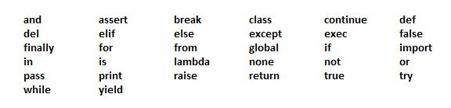
Variables
Not be Python Keywords as displayed in the image below

Slide 32
Variables
Many Values to Multiple Variables
x, y, z = "Orange", "Banana", "Cherry"
One Value to Multiple Variables
x = y = z = " Orange"

Slide 33
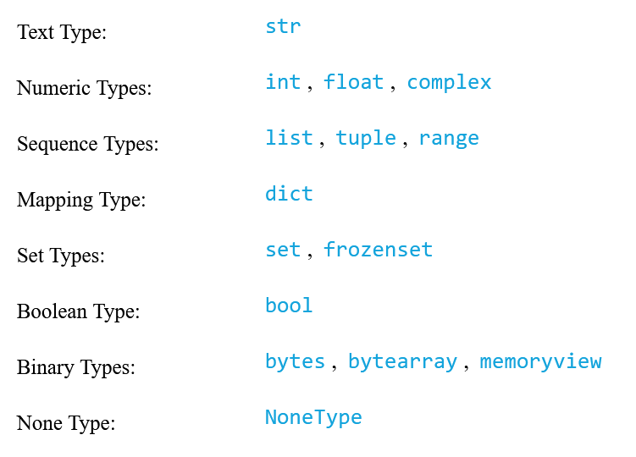
Data types
type(var)

Slide 34
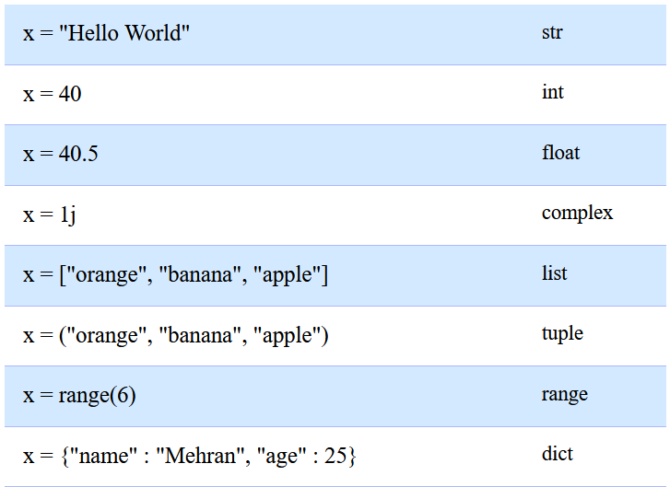
Data types examples

Slide 35
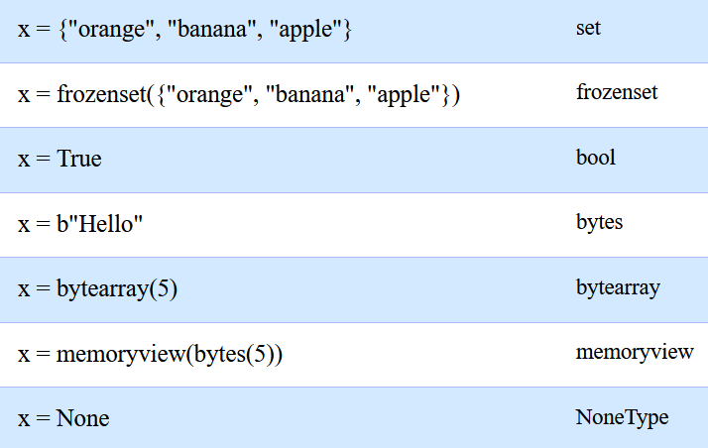
Data types examples

Slide 36
Numbers
int
x = 5
float
x = 5.0
x = 5.5
float(x) # 5.0
int(x) # 5
int(x) # 5

Slide 37
Numbers
round(5.1) => 5
round(5.5) => 6
round(5.551, 1) => 5.6
import random
random.randint(1, 10)

